Slide 1
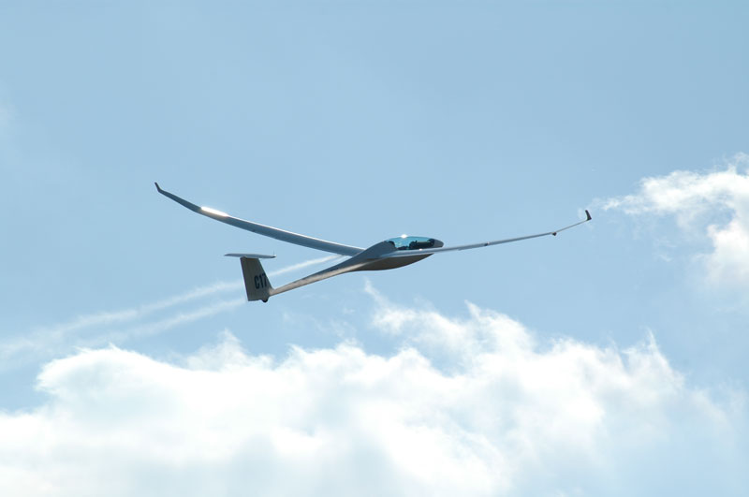
UAB „Sportine aviacija ir ko“ LAK Manufacturer
Debesu 16
Pociunai
LT-59327
Prienai
Lithuania
www.lak.lt

Slide 2

FES development, recent issues and solutions
Notes:
2

Slide 3
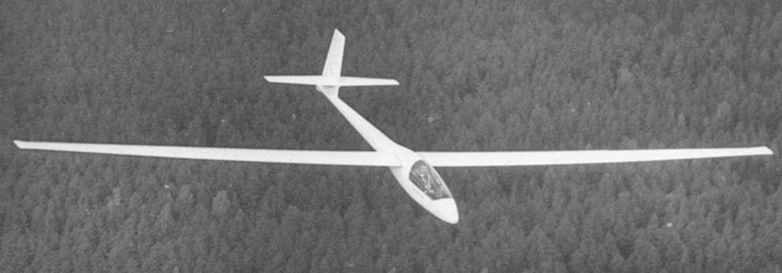
BK-7 the first Lithuanian glider from composite materials. Constructor Balys Karvelis.
(18 m wing span). Maiden flight in 1972

Slide 4
JSC "SPORTINĖ AVIACIJA IR KO"
Lithuanian Aviation Plant (now JSC "Sportinė aviacija ir Ko") was established in 1969. At the time, it was (and still is) the only company in the Baltic States designing, manufacturing and repairing gliders and powered gliders.
Aircraft Factory establishment was based on the old traditions of gliding and long lasting tradition in gliders and aircraft designs in Lithuania.
The first composite glider BK-7 "Lietuva" was built in 1972 and maiden flight took place in December. This glider has become the basis for future aircraft design.
Over 20 different types and modifications of gliders and motor gliders have been designed, built and tested in the history of the plant.

Slide 5
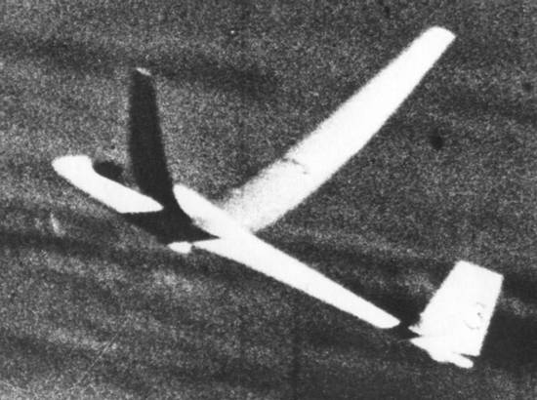
BK 7A (Test flight n_{y}=5,3) (20 m wing span)

Slide 6
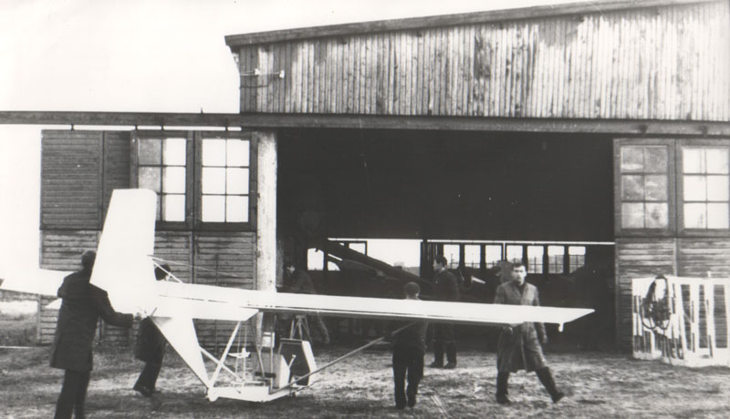
“ZYLE” glider for kids – still in use in all Lithuanian gliding clubs

Slide 7
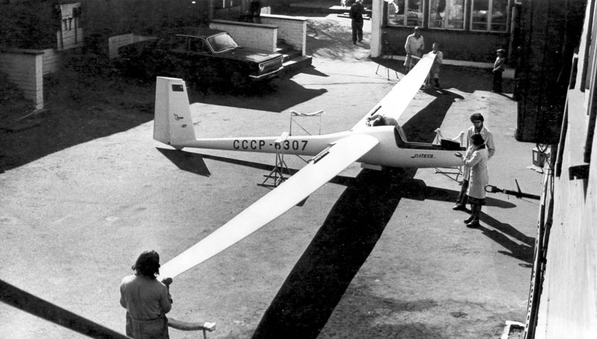
LAK-9: the first LAK flown in European Gliding Championship in Finland

Slide 8
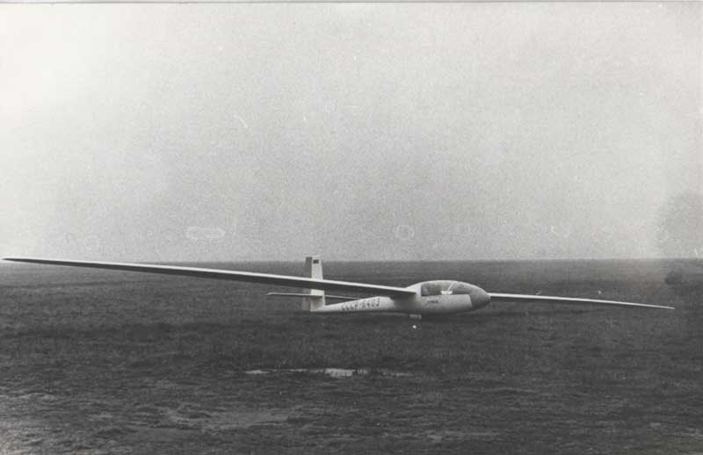
LAK-9M

Slide 9
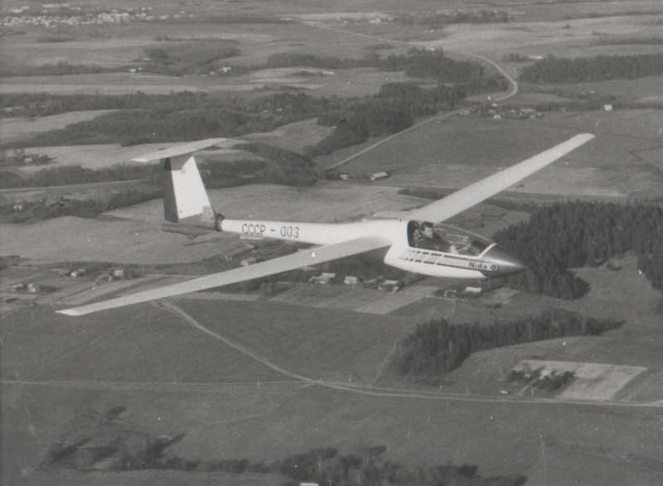
LAK-11 “NIDA”. 15m Class glider

Slide 10
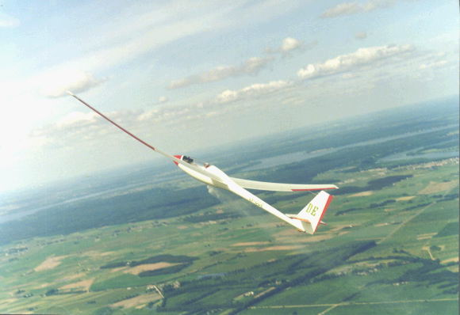
Open Cass glider LAK-12, 1978, carbon fiber spar, just 6 years after the first BK-7

Slide 11
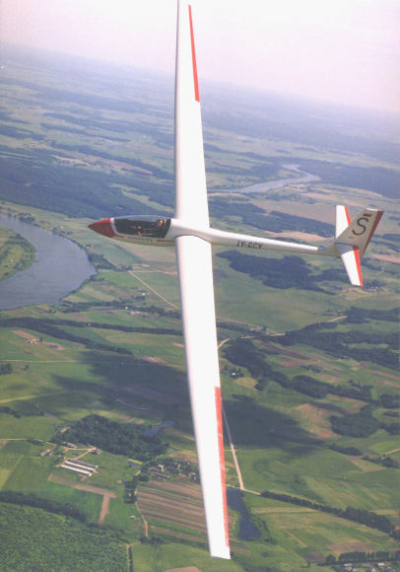
LAK-12, over 150 glider flying World wide, not a single pilot killed !

Slide 12
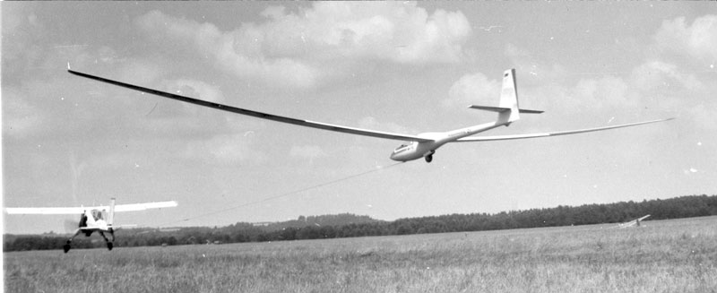
LAK-12E 1989
Prototype of a single seat Open Class glider with 26m wing
span and calculated glide ratio of about 60.

Slide 13
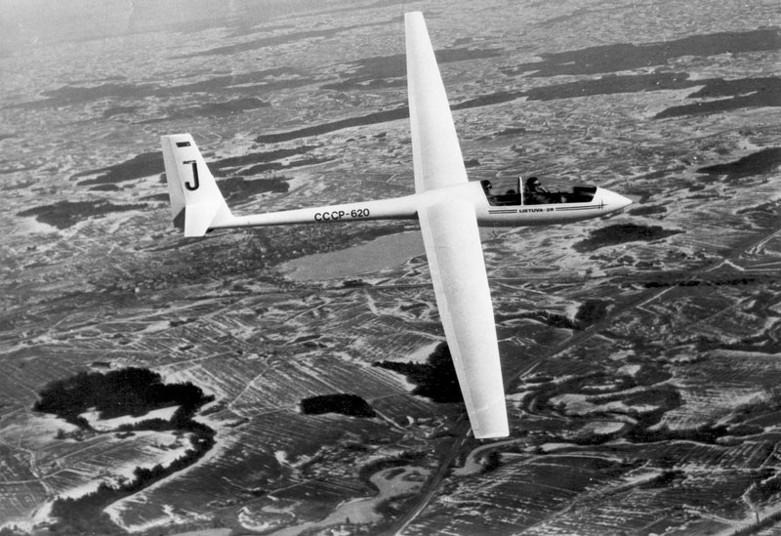
LAK-12-2R Open Class two seater. 1986.

Slide 14
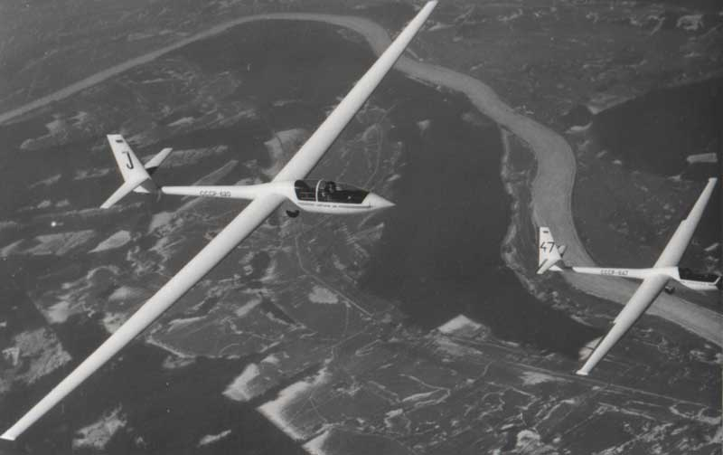
LAK-12 and LAK-12-2R. Flight for comparison. 1986

Slide 15
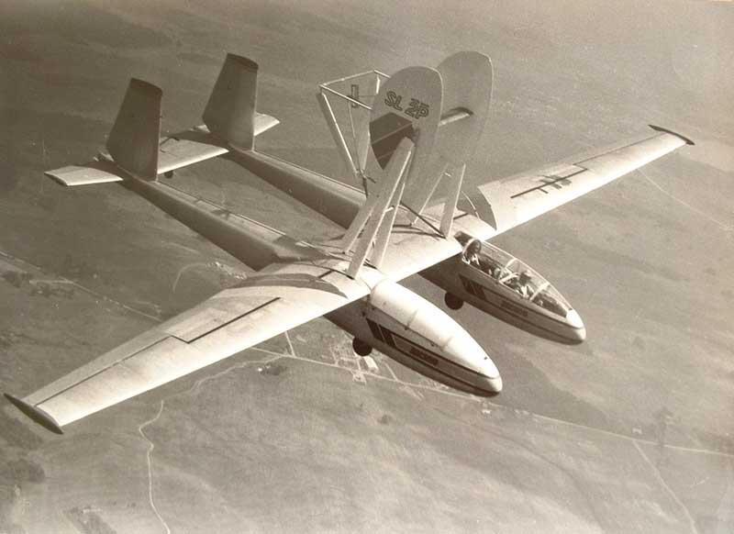
L-13 “BLANIK”, “flying lab”, SL-2 1987

Slide 16
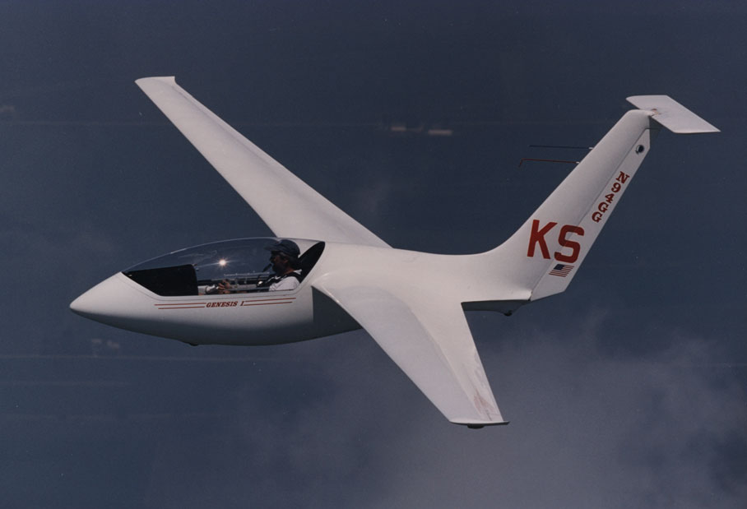
Genesis, Since 1996, we have worked on the American design standard class glider Genesis. We have developed the engineering part of the design, we completed the strength tests and calculations in accordance to JAR-22. Obtained Type Certificate and 26 units have been made.

Slide 17
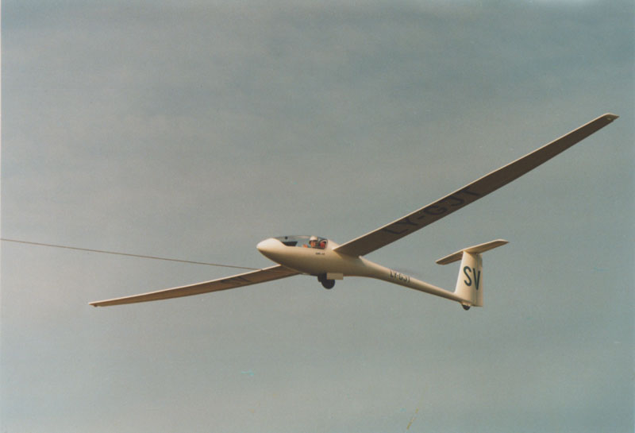
LAK-17 PROTOTYPE, new technologies 1998

Slide 18
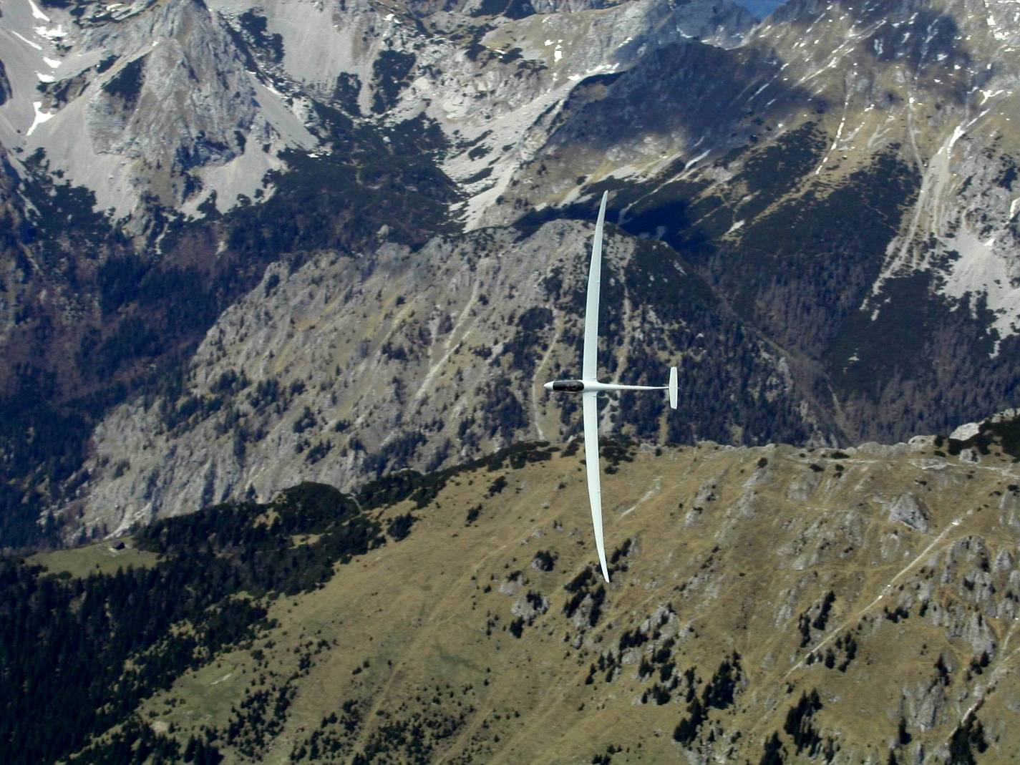
Nowadays
LAK-19

Slide 19
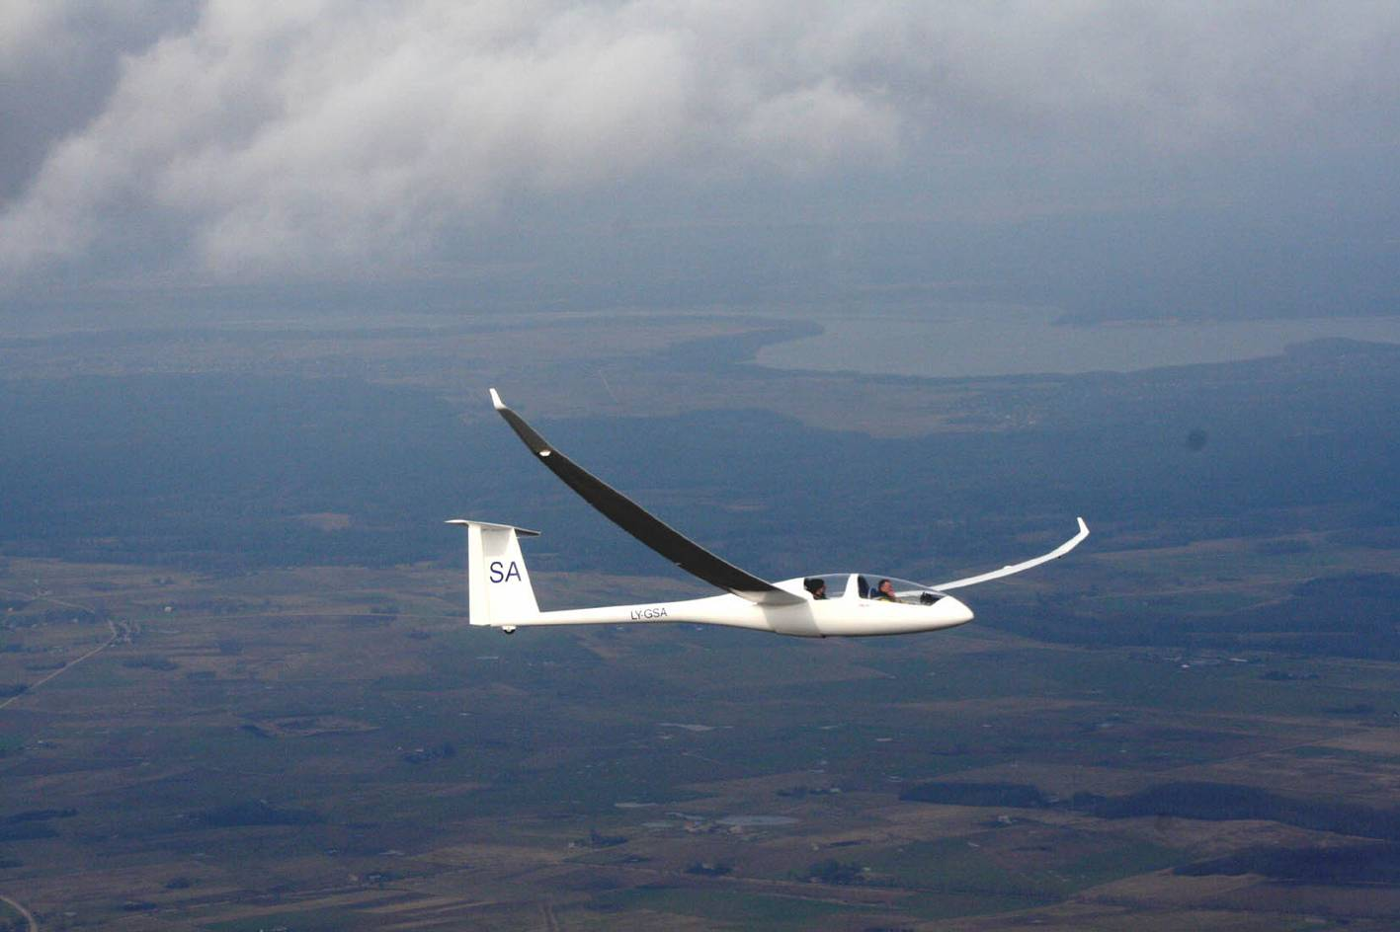
LAK-20 and LAK-20M
Two seat open class sailplan

Slide 20
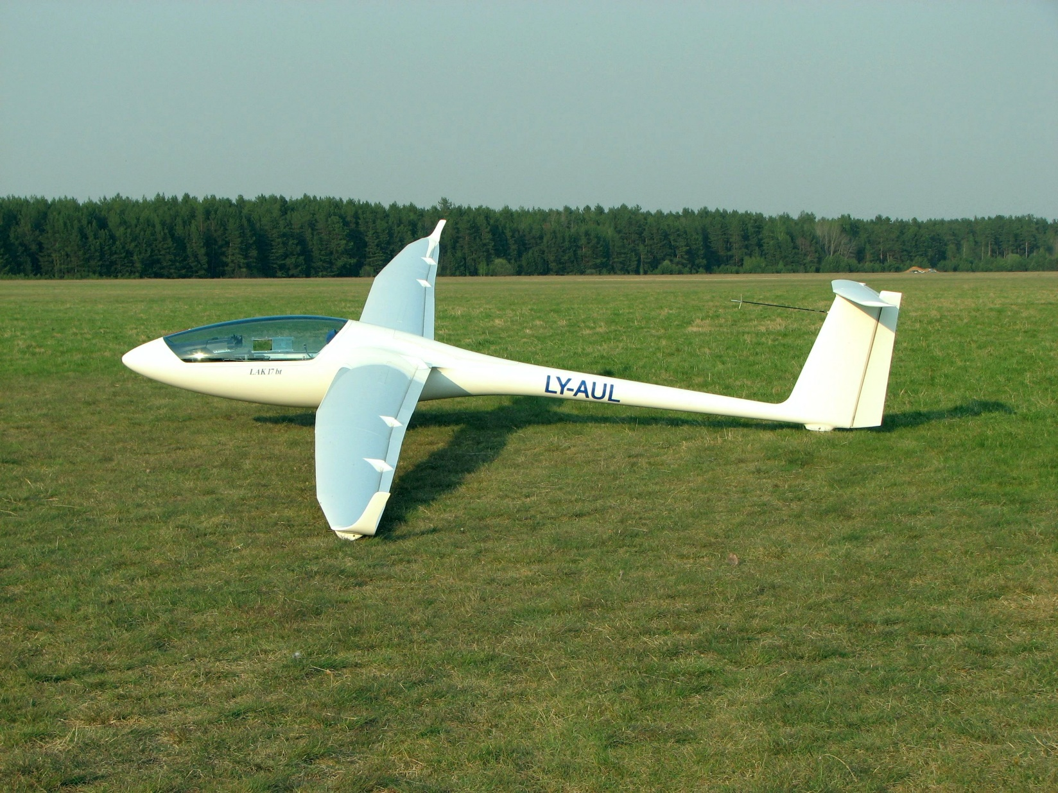
LAK-17B, new wing profile, increased wing loading

Slide 21
Over the past 15 years after the company became private, LAK-17 type glider was developed and modified, and about 220 units of gliders in 15 m and 18 m Classes were manufactured and delivered to the customers all over the World.
Few prototypes of the Open Class two place glider LAK-20 and LAK-20M have been made, but due to the low market we do not proceed with the project now.
The most revolutionary and progressive product is LAK-17B-FES: Front Electric Sustainer.
The glider was certified by EASA and we hope that it starts new Era in safety of glider flying.
It is well known that many powered gliders had accidents due to the engine failure during start up at low altitude. Our electric system is many times more reliable. Even if it fails, the motor does not create additional drag and the pilot may continue to fly the pure glider and land safely.
We produce trailers LAK-T5.
Designers and engineers have university education and many years of experience of work on modern gliders. Many workers have over 20 years of experience and they share it with their young colleagues.
We have 47 employees.
And net of Dealers all over the World.

Slide 22
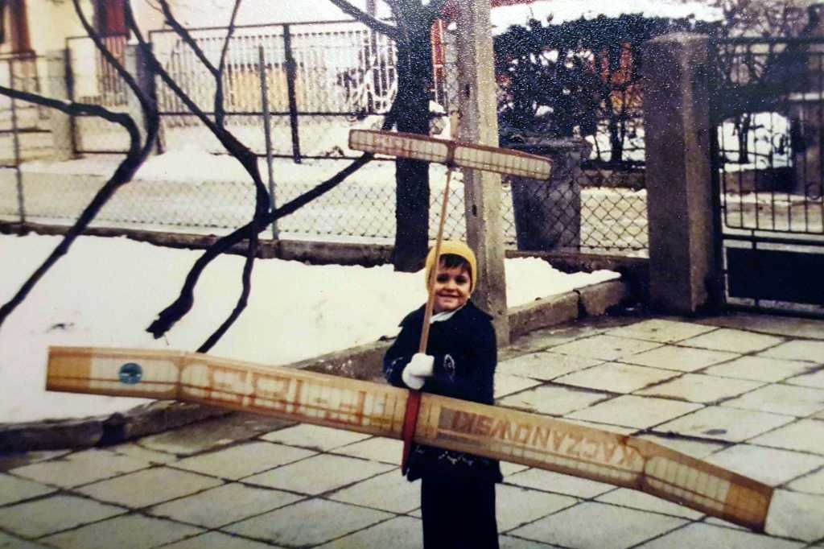
Luka 3 years old
Notes:
22

Slide 23
Luka Žnidaršič, experienced glider pilot,
LAK Dealer
2800 gliding hours
2x JWGC, 4x WGC
In 2009 established LZ design company

Slide 24
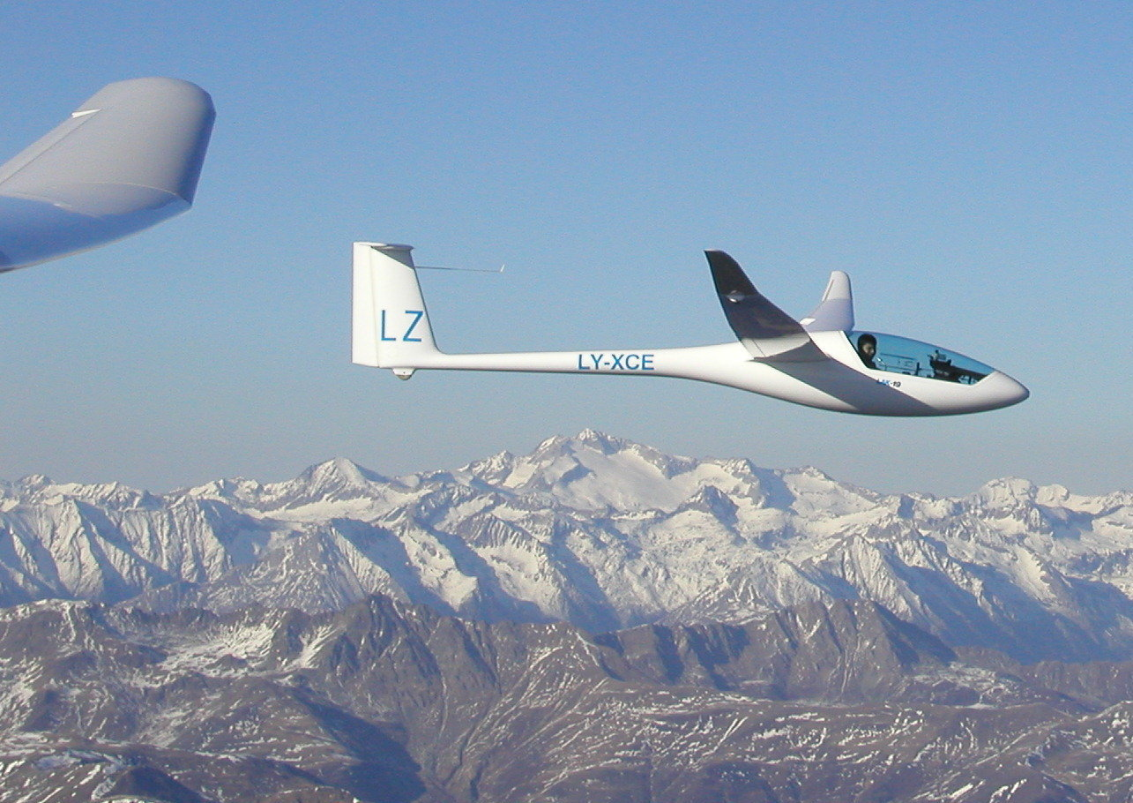
LAK-19

Slide 25
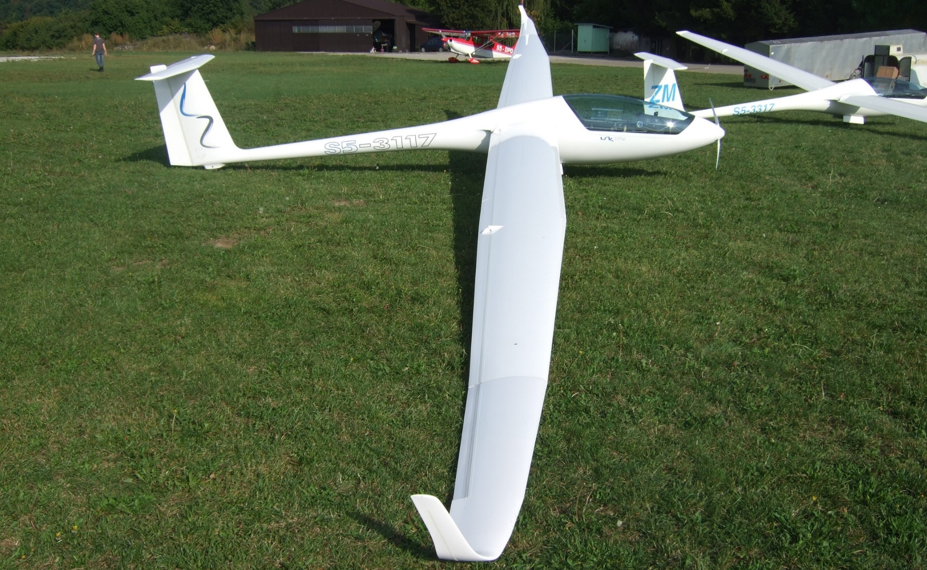
LAK17A FES, SAFETY & COMFORT
Notes:
25

Slide 26
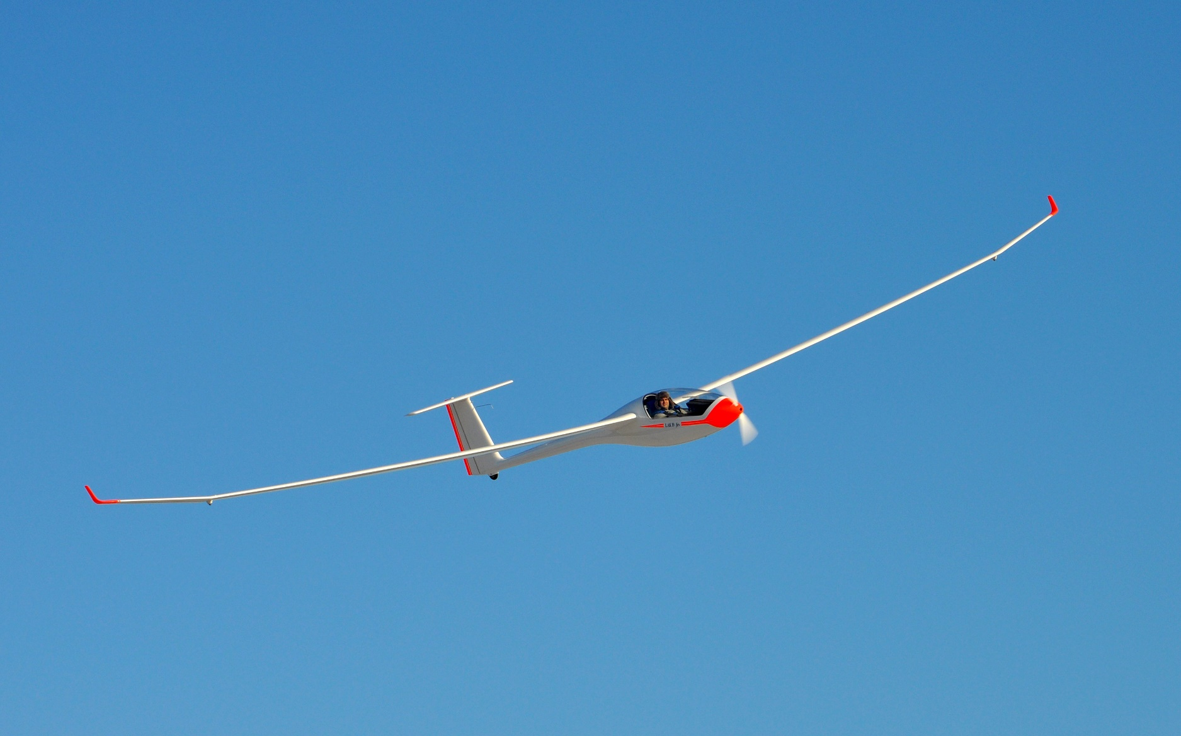
LAK-17B-FES, Front-electric-sustainer
New generation - glider with electric motor

Slide 27
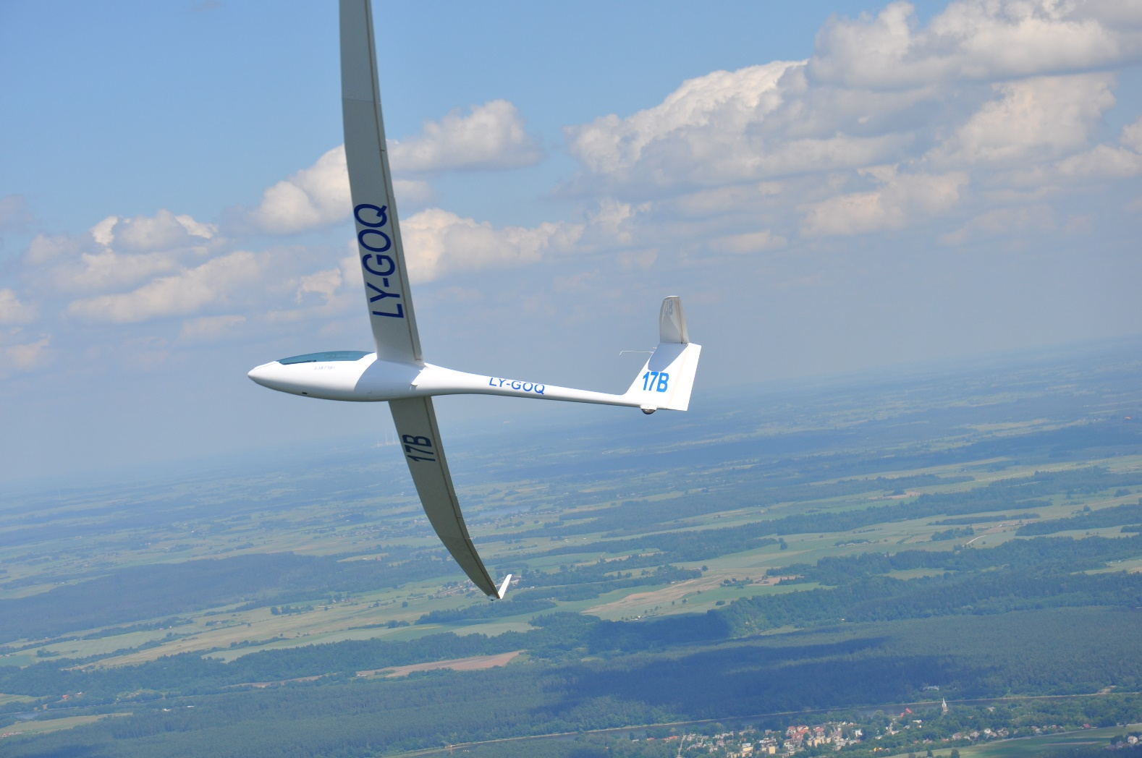
LAK-17B-FES, free flight

Slide 28
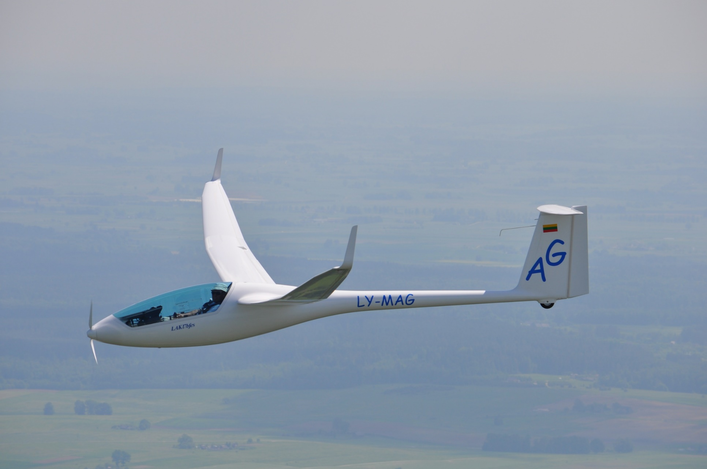
New training opportunities
1000 km flown in Lithuania

Slide 29
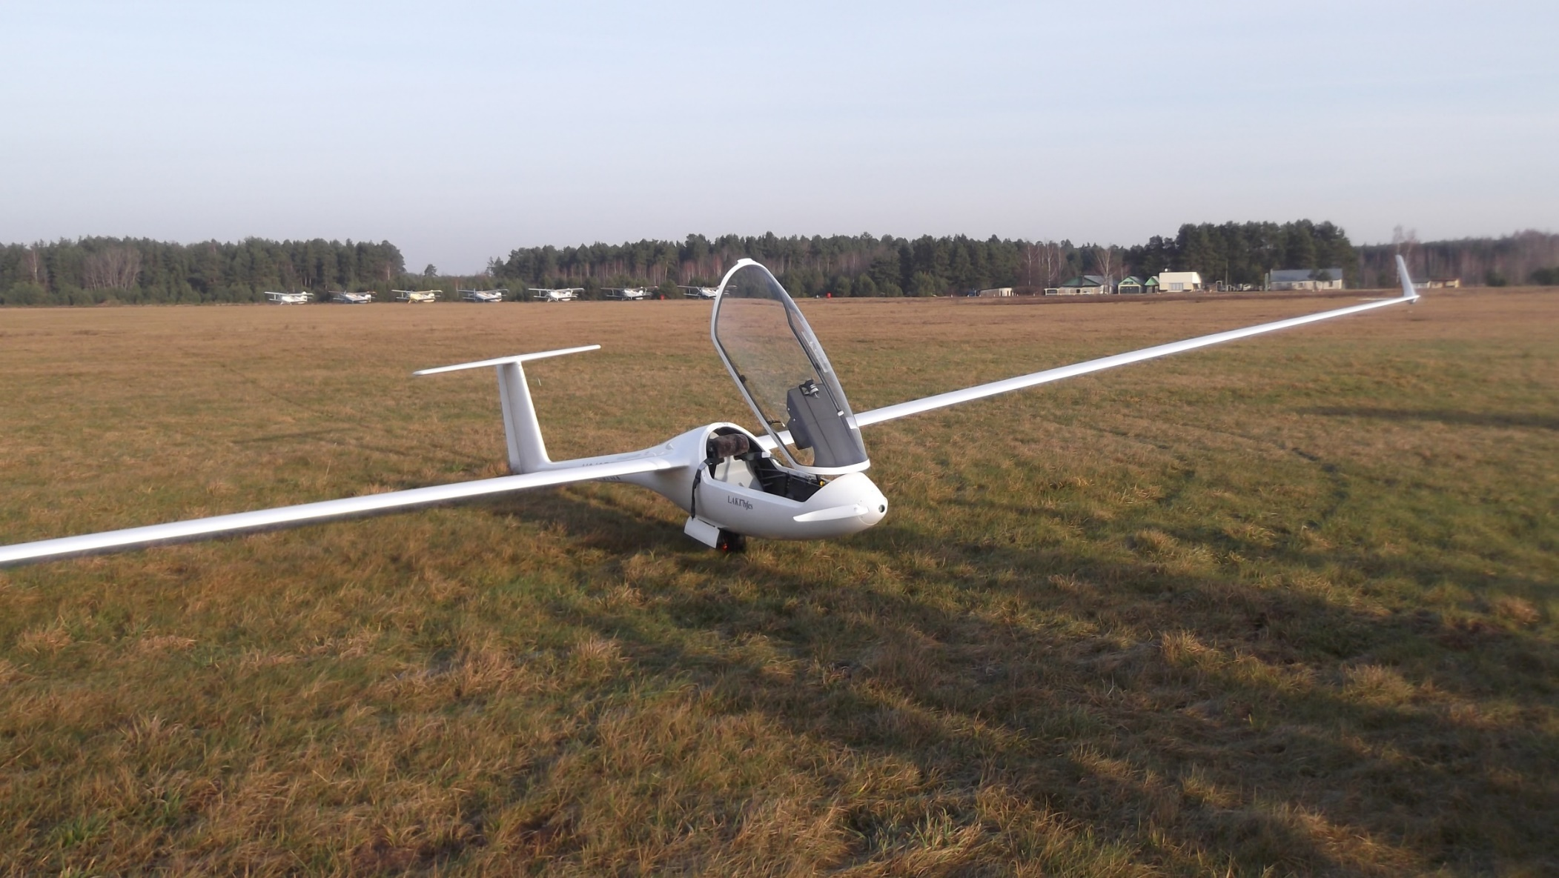
Reach your home base or safe field to land

Slide 30
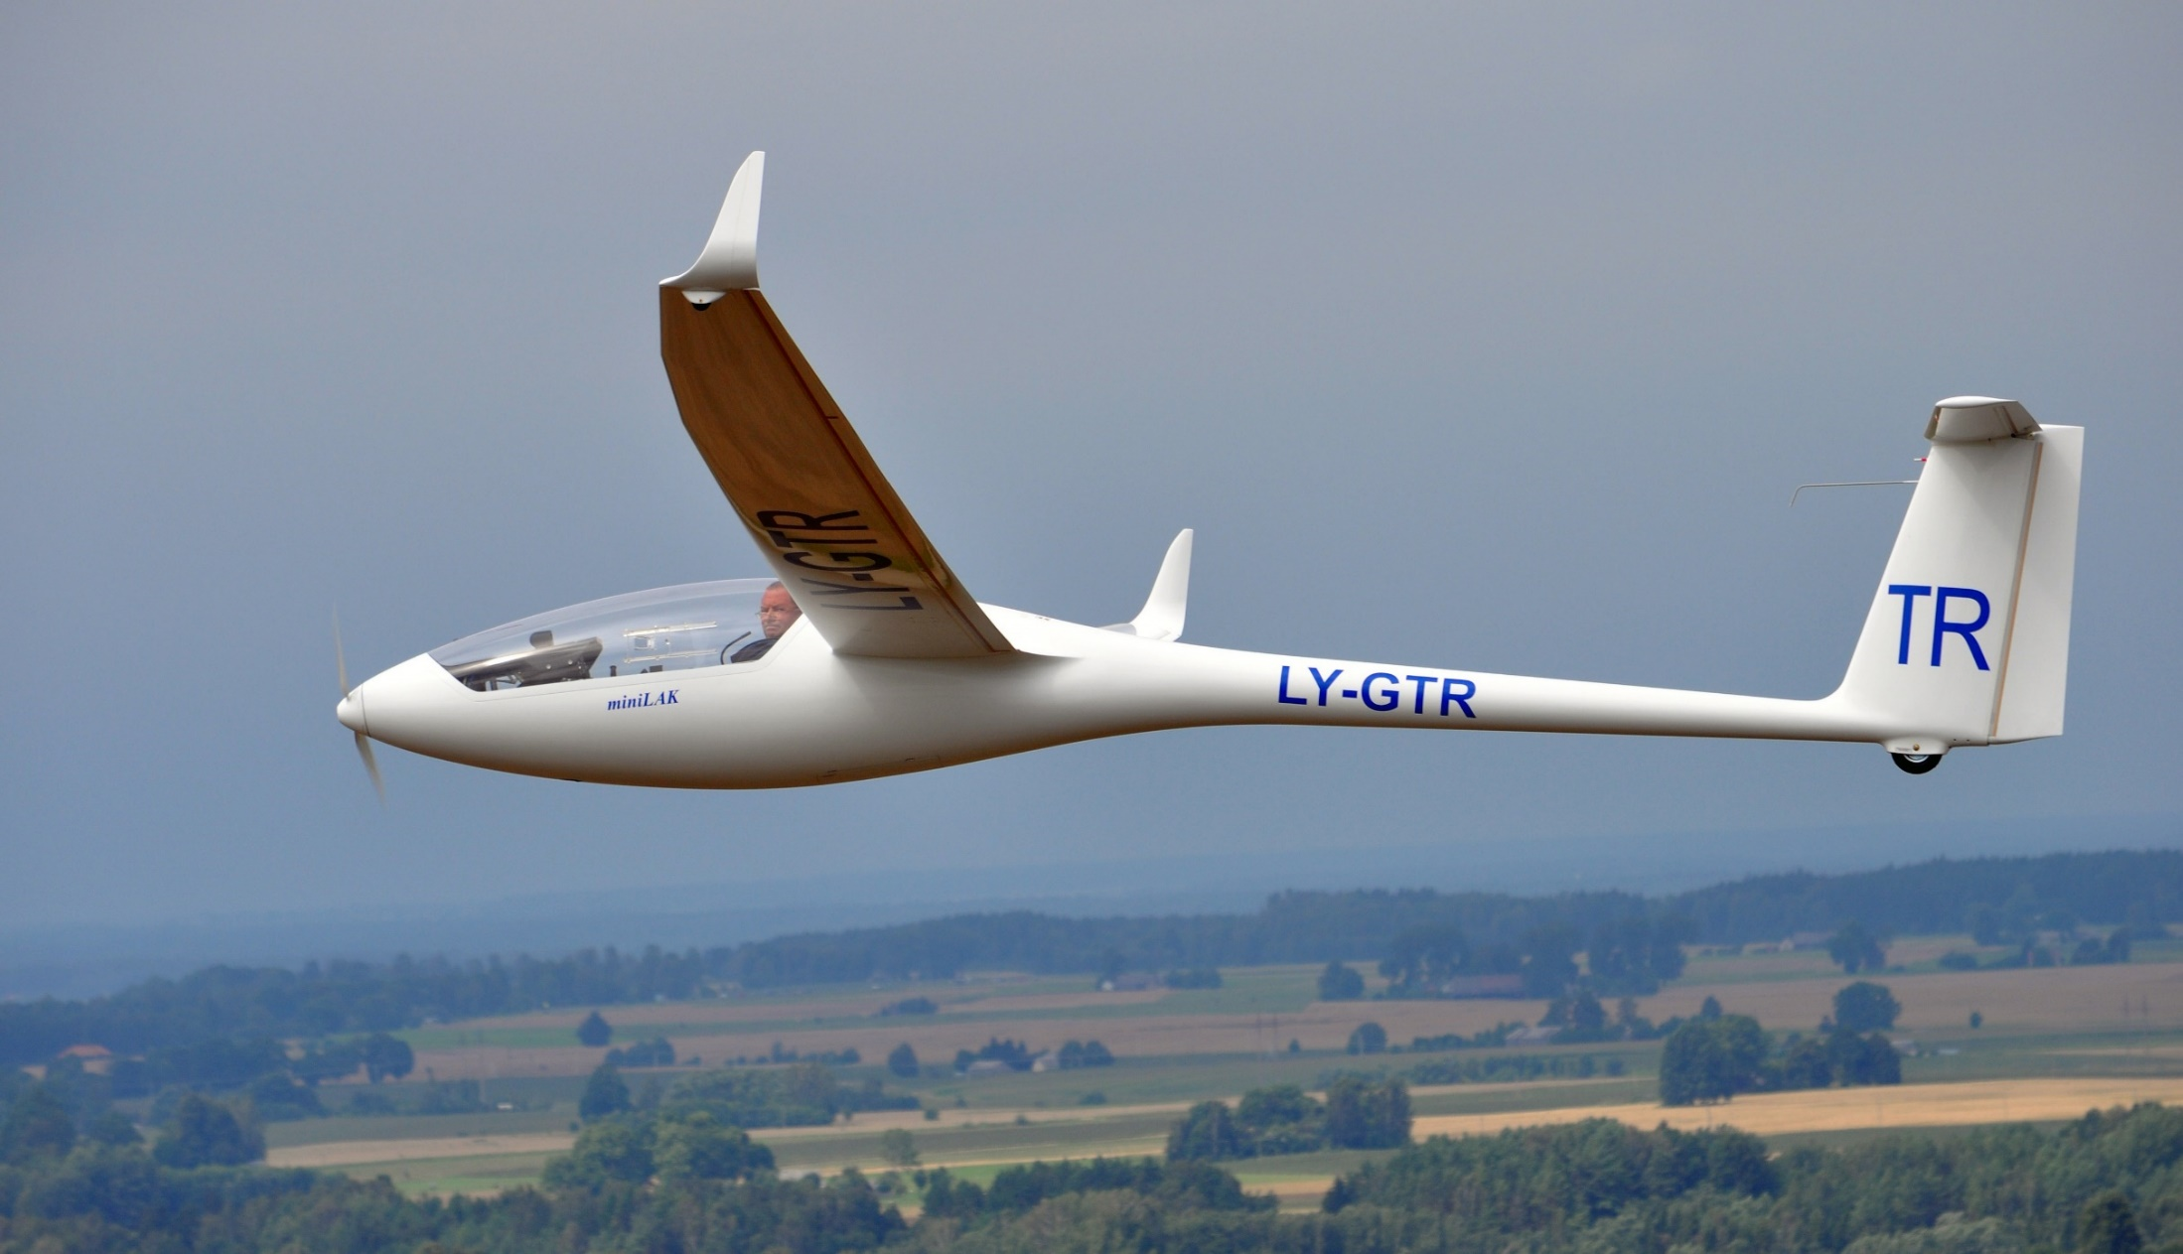
MiniLAK FES
Notes:
30

Slide 31
EASA certified types in operation 2017:
LAK17B FES
HPH304 ES
Discus 2c FES
Other types:
EASA Permit to fly LAK-17A (EASA certification procedure)
Annex II in EU, National permit to fly or Experimental in USA.
8 years no major issues
May 2017, fire in CZ while in trailer
August 2017, another fire happened in UK at landing
8.9.2017, EASA issue an AD (Airworthiness Directive)

Slide 32
Problems:
A. Pilots do not read manuals and do not follow instructions at all:
One battery pack was dropped from the car booth on the concrete.
Voltage disconection cable was not disconected during storage of the glider in it‘s trailer.
The FCU was not switched on during flights, no control of the batteries...
  B. Possible problems which may occur during assembly of the battery packs.
Foreign objects between the cells which could destroy the plastic cover of a cell.
It is enough to damage cover of a single cell and it may start fire.
2. Low fire rezistance of old batterie boxes
    C. Problems coming from manufacturer of the cells, KOKAM?
1. Changes in technology of the contacts?

Slide 33
The British Gliding Society started initial investigation, but due to the complicity of the task, it was passed to the official British Aviation Incidents Investigation Authorities. Modern technologies were used. Tests of the cells were carried out.
Even damage of a single cell may cause fire.
The battery packs were inspected using X-ray and some small metal particles were found between the cell is some. They could damage plastic cover of a cell…

Slide 34
1.Testing different theories
2.Searching solutions
3.Testing solutions
4.Presenting solutions to manufacturers

Slide 35
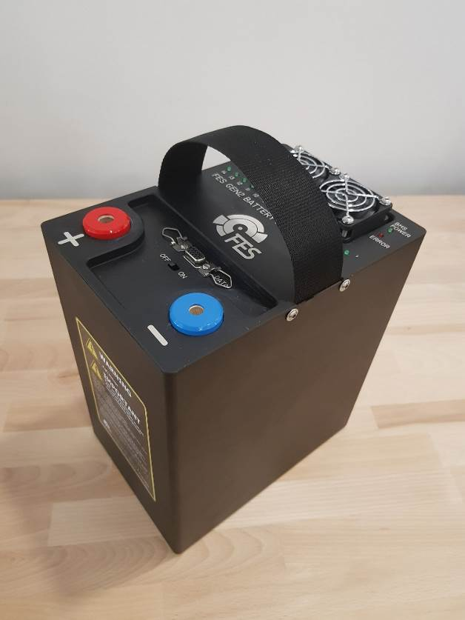
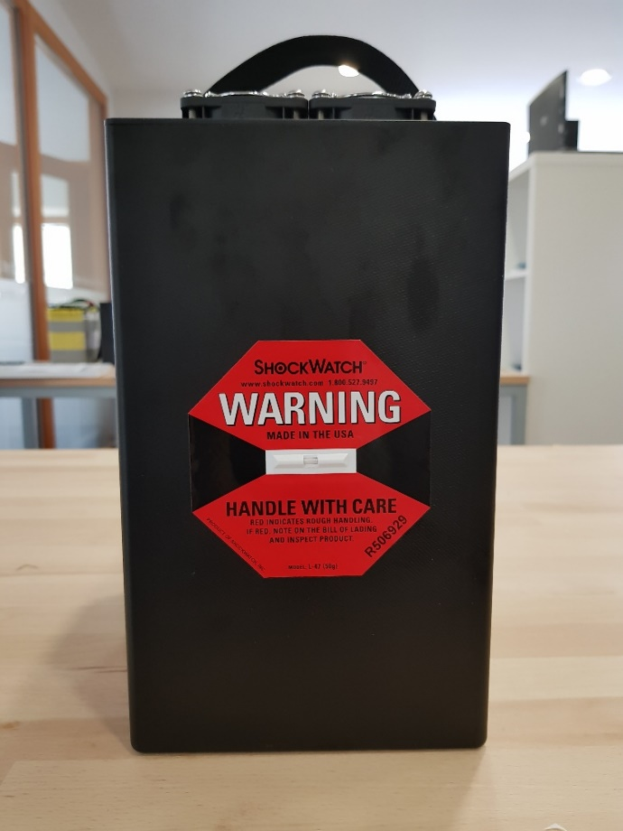
Stronger battery pack housing
built from high temperature resistant prepreg
increased wall thickness
improved layup of fabric
50G ShockWatch sticker

Slide 36
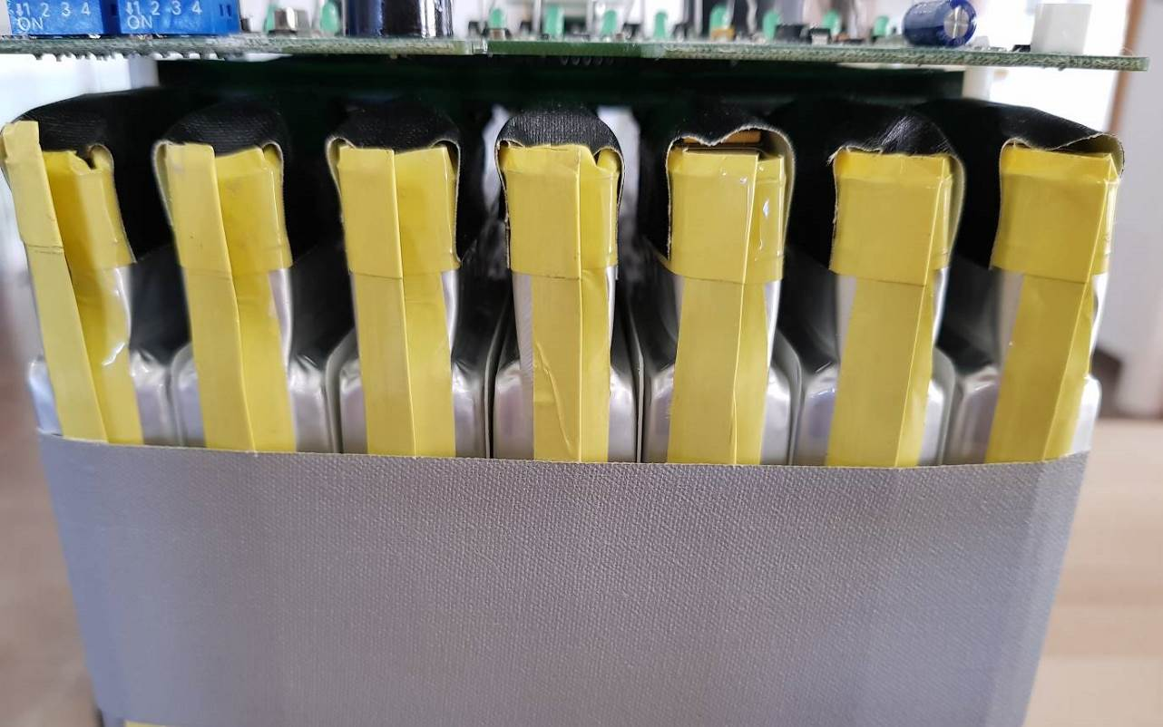
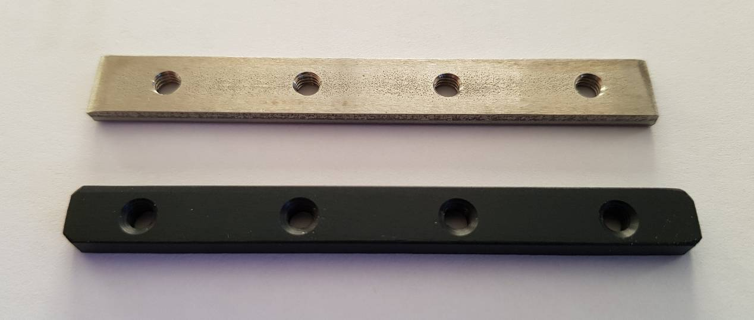
Internal improvements, better isolated contacts

Slide 37
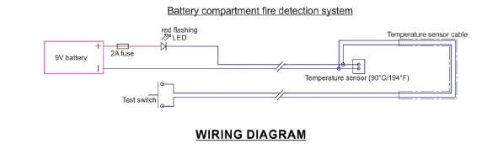
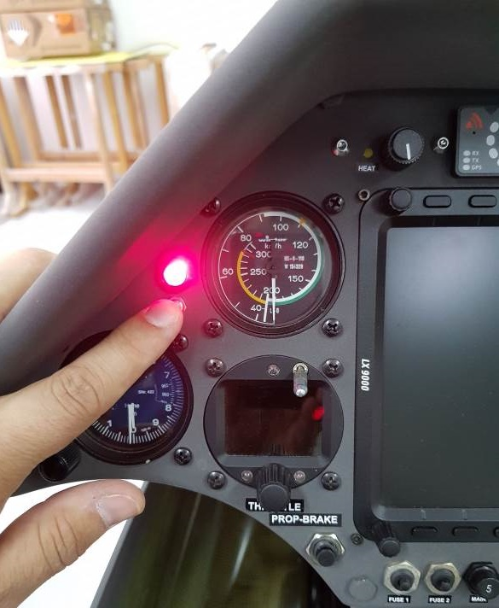
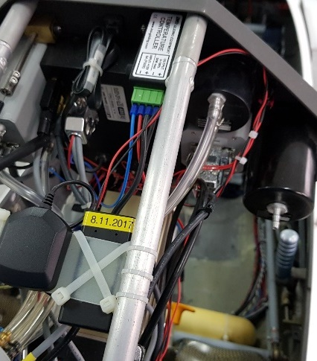
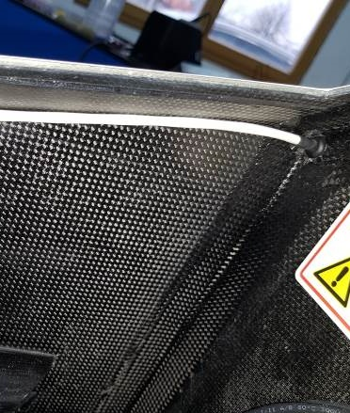
Fire detection system

Slide 38
FCU software modifications
Warnings priority:
Three different types of acoustic signals
Recall of messages
Automatic engine strop after 30 seconds if not override by pilot
Logging of all parameters and appearance of messages to internal SC card
-logging to SD card introduction

Slide 39
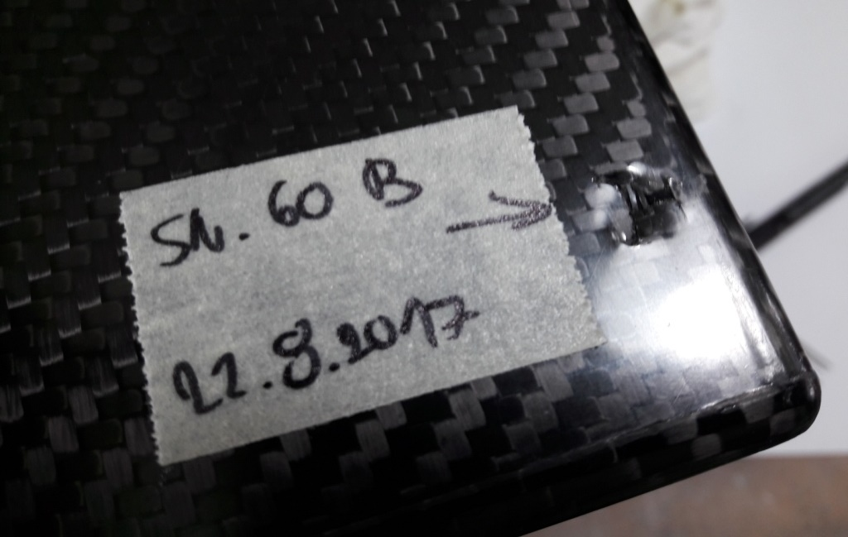
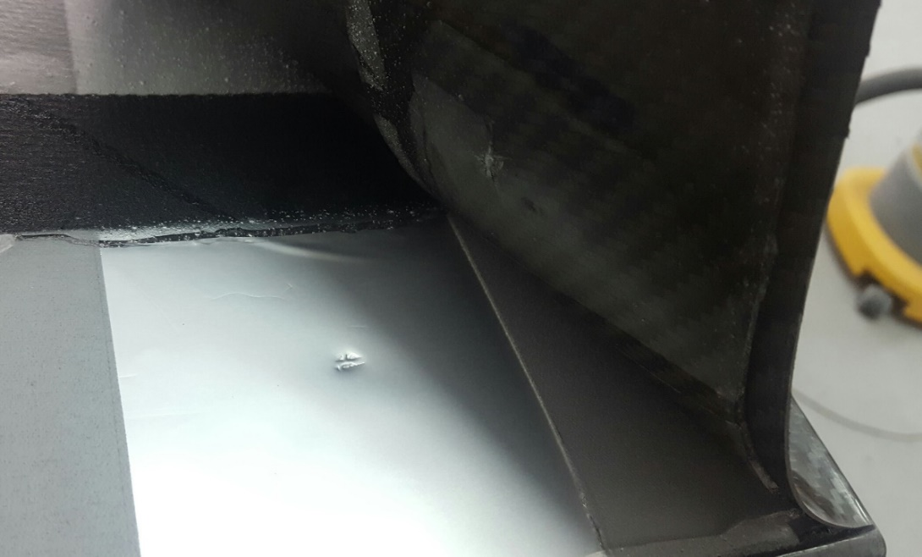
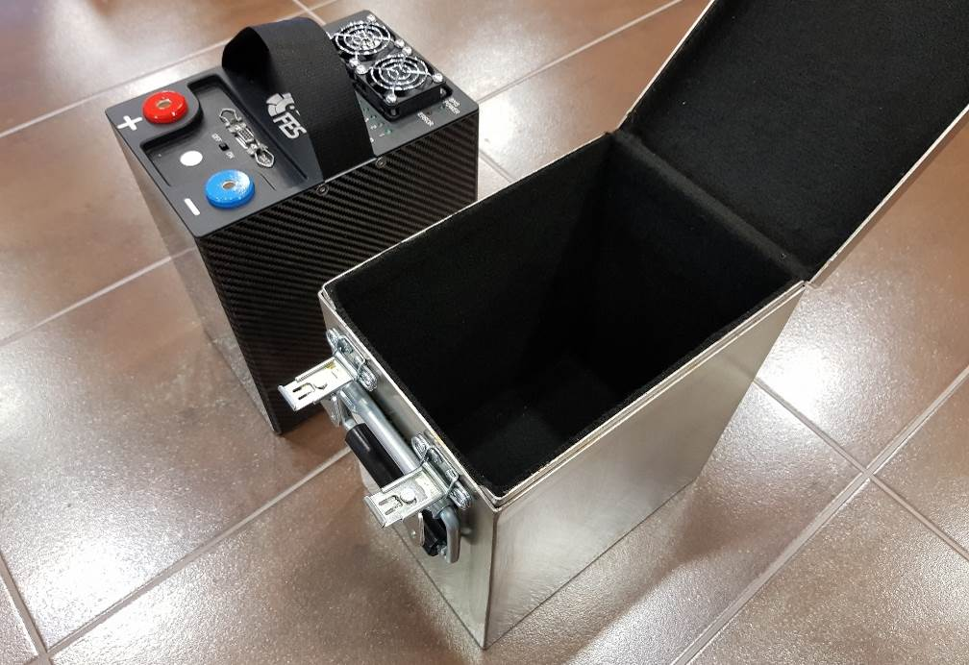
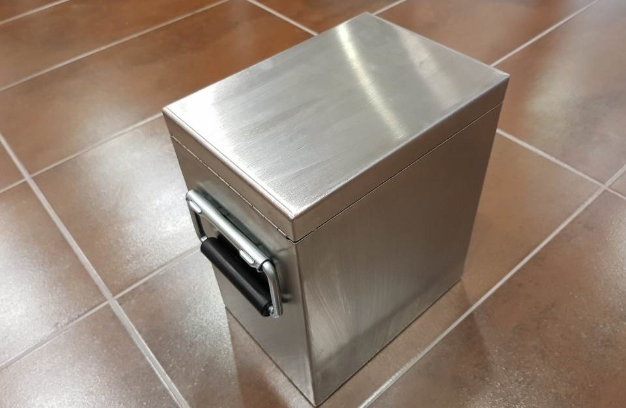
FES Batteries transport/storage stainless steel box (standard equipment for new gliders)

Slide 40
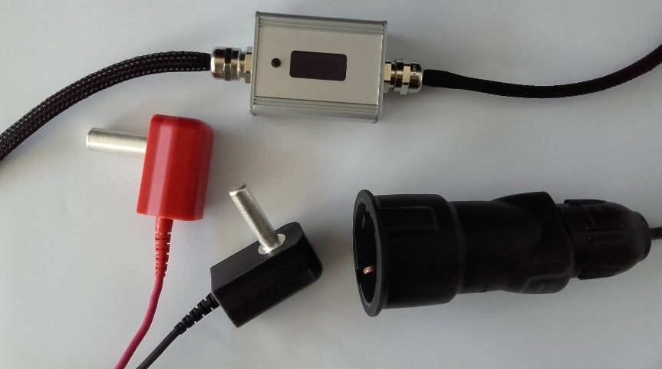
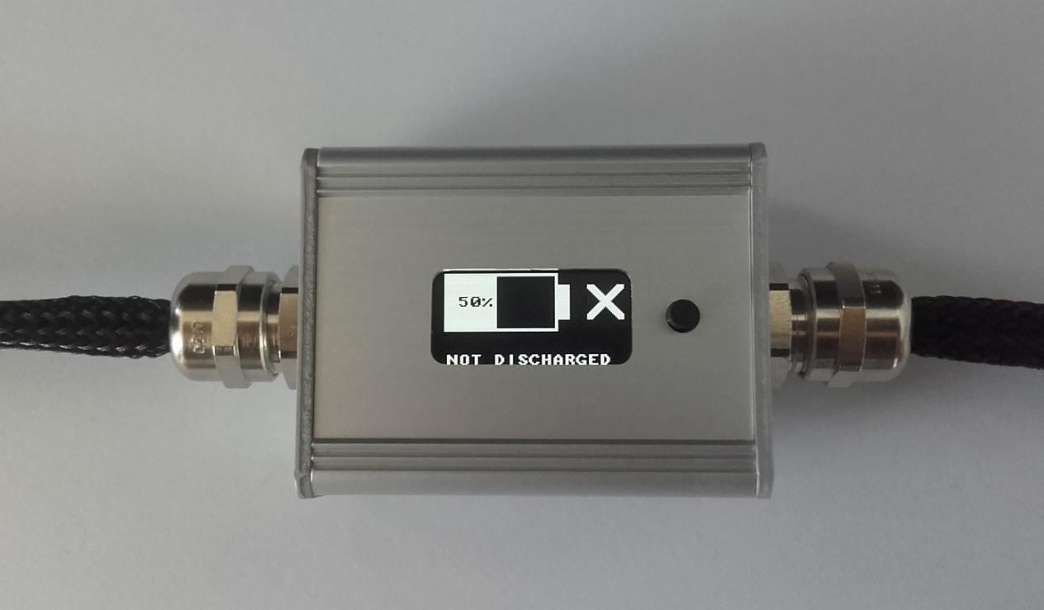
FES discharging assistant (standard equipment)

Slide 41
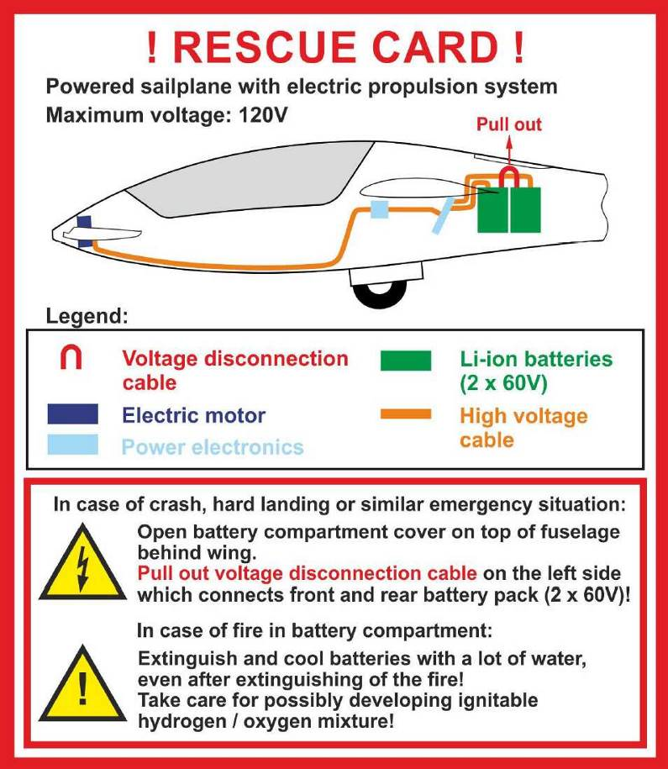
Modification of manuals

Slide 42
Manufacturers applied for modification approvals
EASA approvals were issued:
20.12.2017, bulletin of Sportine Aviacija was approved by EASA and we started implementing it in all FES gliders.
All battery packs must be shipped to LZ Design for inspection and reassembly in new fire resistant boxes.
FCU – re-programmed.
We ship fire warning sensors with prewired warning light and customers ge instructions how to install them locally.

Slide 43
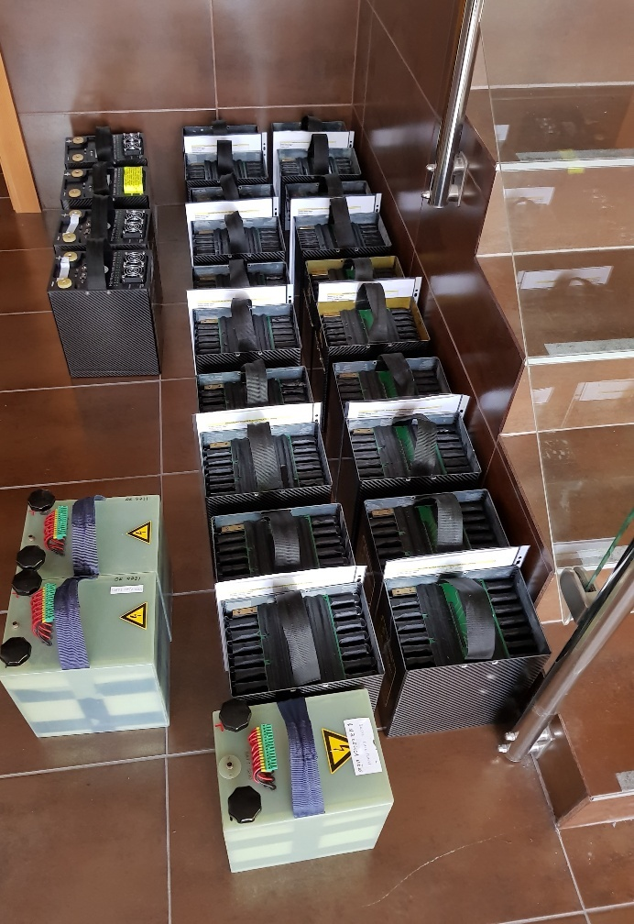
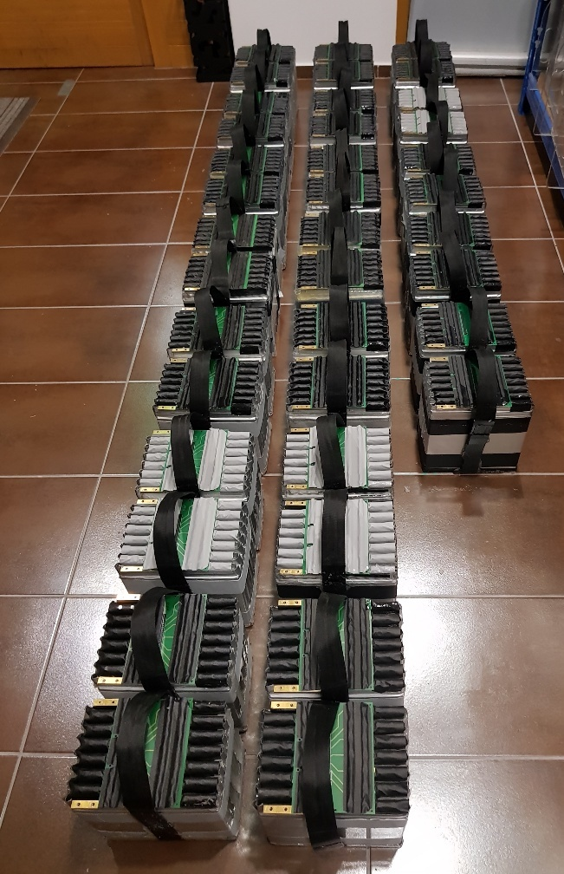

Slide 44
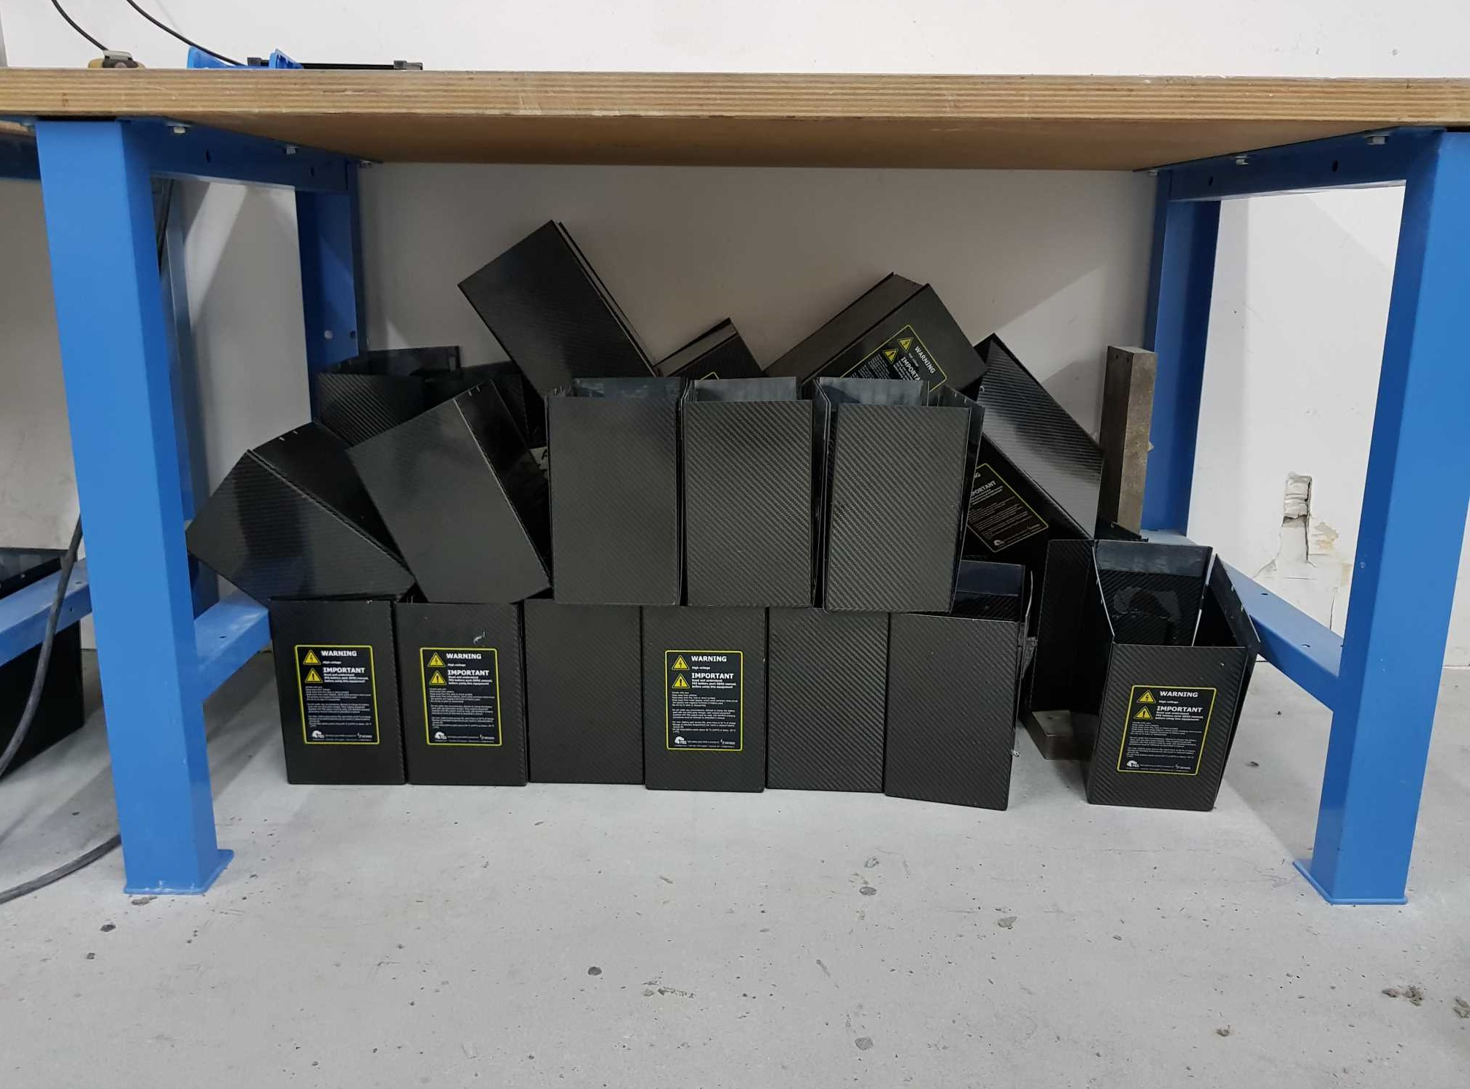

Slide 45
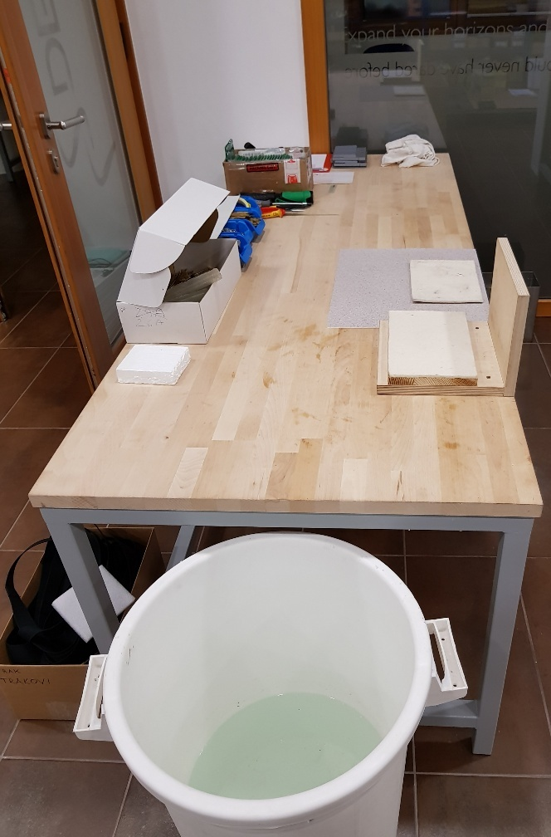
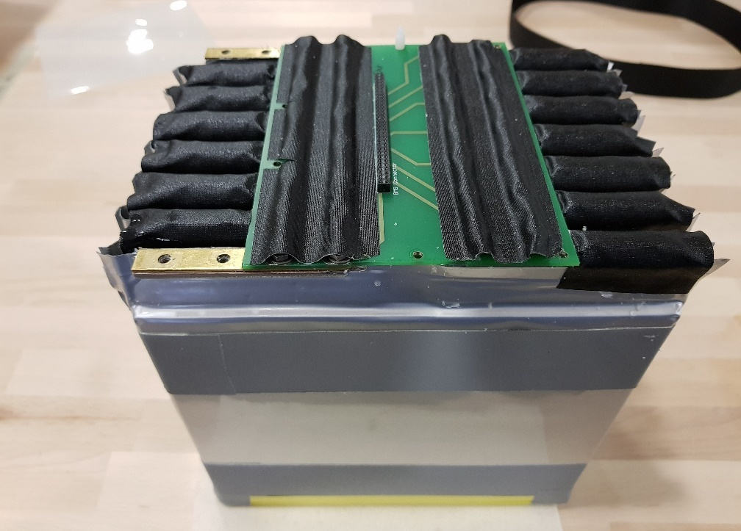
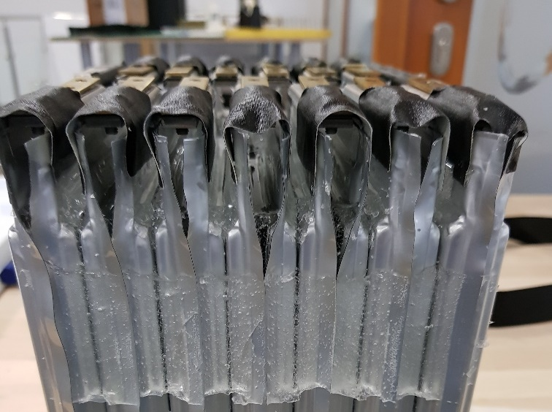

Slide 46
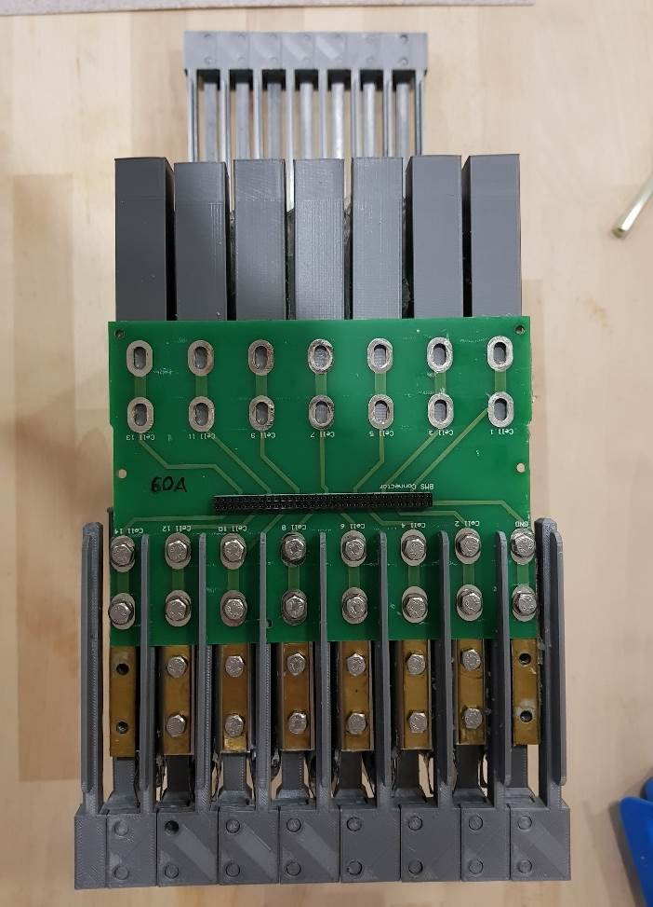
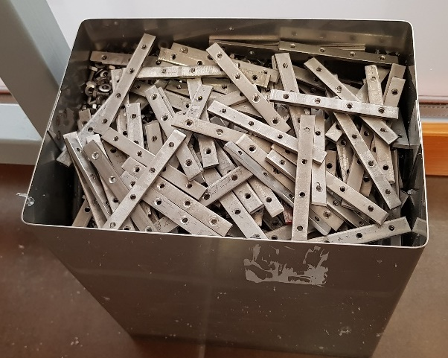
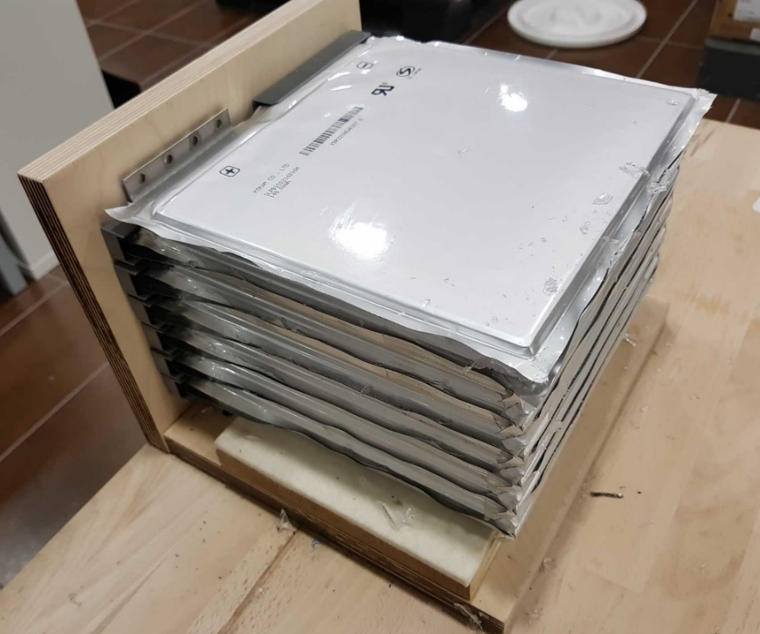

Slide 47



Slide 48


Slide 49



Slide 50


Slide 51


Slide 52


Slide 53

New era started when Self-launching miniLAK-FES
did it’s maiden flight in 2017

Slide 54

Our credo:
SAFETY, INDEPENDENCE, COMFORT

Slide 55

Thank you for your attention!

